Slide 1
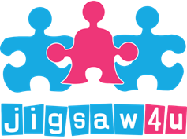
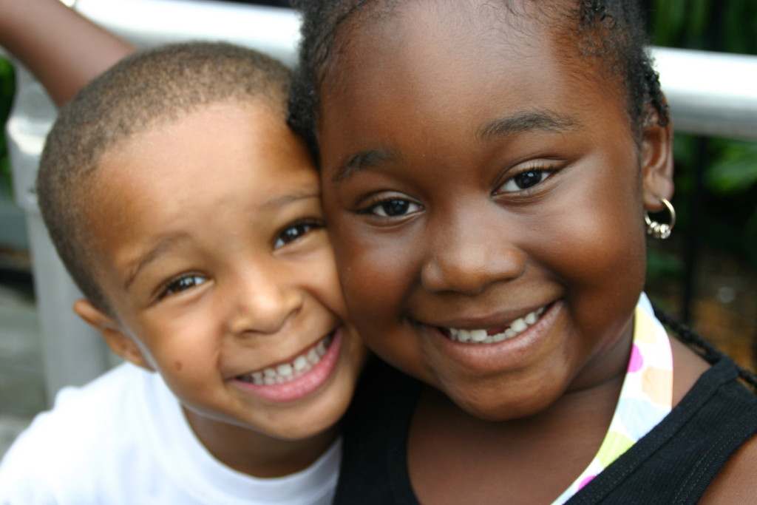
Helping children and young people
put the pieces back together
Children can be forgotten when someone dies in the family. Adults can find it difficult to know what to say to children and how much to involve them in the process. Jigsaw4u have been working in this area for nearly 20 years and are particularly skilled at ensuring children’s voices are heard after a loss or bereavement.
This training session will help participants to understand the effects of grief of loss, how to support someone who has experienced a bereavement and specifically looking at how to understand the effect of bereavement on children.
Grief & Loss Training
Who is the training for?
An understanding of the difference between loss, grief and bereavement
An overview of theories of grief and loss
An understanding of children’s developmental grief responses and needs
An understanding of how to support children and young people’s grief needs
This training session would be useful for any adult who comes into contact with children through their line of work, particularly professions such as: social workers, child and family support workers, teachers, TAs, faith based community leaders and health care professionals.
Learning Objectives
To book or for more information, please contact us on:
Phone: 0208 687 1384 Email: training@jigsaw4u.org.uk Website: www.jigsaw4u.org.uk
Charity No. 1109167

